Slide 1

IGCSE Physics Learning Log
Name____________________________
Look after this booklet – do not lose it.
Do not leave tasks until the last minute before the deadline.
Automatic detention if you do not have it with you on the deadline day.

Slide 2

Blurting
Write down everything you remember about a topic
Check the Revision PowerPoints on the classroom
Add/correct your blurt without looking at the information
Look, cover, check
For trickier topics, look at the Revision PowerPoint first, then blurt and check
Dual coding
For topics with multiple stages e.g. protein synthesis or eutrophication, look at the Revision PowerPoint first then create a visual (diagram or cartoon strip) to show the stages
Techniques that do not work well:
Just reading
Writing lots of notes from the text book
Re-writing notes in the same format
Copying
Just doing past exam questions – this tests your learning but could leave you with knowledge gaps.
How to use this Learning Log:
Blurt from memory
Check using secondary sources
Correct from memory in a different colour

Slide 3
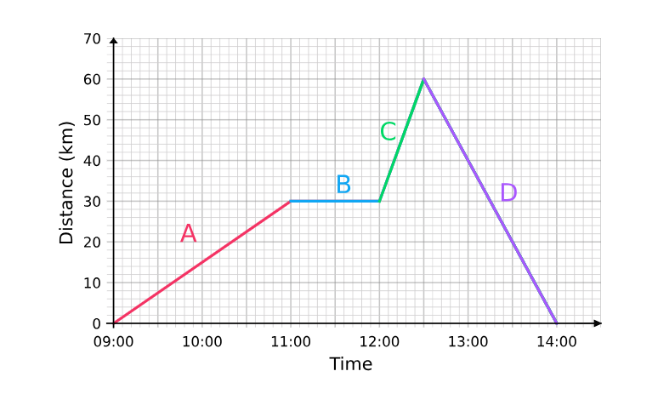
Task 1 Complete by__________________
Forces and motion
Complete the table from memory only:
Quantity | Name of units | units
Mass
Length
Speed/velocity
Acceleration
Weight
Time
Acceleration due to gravity
Moment of a force
Momentum
Explain what is happening at A, B, C and D

Slide 4
Task 2 Complete by__________________
Forces and momentum
Calculate the speed at A, B, C and D
Explain how to investigate the motion of everyday objects such as a toy car or tennis ball

Slide 5
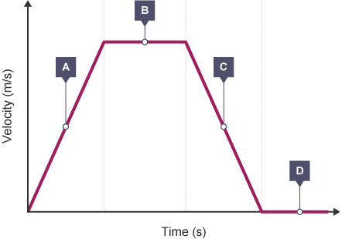
Task 3 Complete by__________________
Forces and motion
Write out the equation for calculating acceleration
Explain what is happening at A, B, C and D
Explain how you would calculate acceleration for the graph above
Explain how you would calculate distance travelled for the graph above

Slide 6
Task 4 Complete by__________________
Forces and motion
Write out the equation that shows the relationship between final speed, initial speed, acceleration and distance
Complete the sentence:
A force can change an object’s ____________, _____________ or _______________
Complete the table:
Examples of contact forces | Examples of non-contact forces
What is the difference between distance and displacement?
What is the difference between speed and velocity?

Slide 7
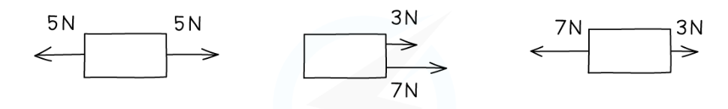
Task 5 Complete by__________________
Forces and motion
Work out the resultant force for each examples:
What is the definition for friction?:
State the equation for calculating force from mass and acceleration
State the equation for calculating weight
Write out the formula for calculating stopping distances
Describe the factors affecting stopping distance

Slide 8
Task 6 Complete by__________________
Forces and motion
Describe the forces acting on a falling object and explain why it reaches a terminal velocity
Explain how you can investigate how extension varies with force on a helical spring, metal wire and rubber band.
State Hooke’s Law and explain why it does not always apply to a spring
What is elastic behaviour?

Slide 9
Task 7 Complete by__________________
Forces and motion
What is the formula for calculating momentum
Discuss 3 safety features in cars that are related to momentum
State the equation for calculating force from momentum and time
State Newton’s 3rdLaw
What is the equation for calculating moment?
What is the centre of gravity of an object?

Slide 10
Task 8 Complete by__________________
Electricity
Complete the table from memory
Quantity | Name of units | units
Current
Charge
Energy
Resistance
Time
Potential difference
Power
Explain how the following protect domestic appliances:
Insulation
Double insulation
Earthing
Fuses
Circuit breakers

Slide 11
Task 9 Complete by__________________
Electricity
Explain how a toaster works in terms of resistance
What is the formula for calculating power?
What is the formula for energy transferred using current, voltage and time?
W
What is the difference between the current supplied by mains electricity and a battery?
Why is a parallel circuit more appropriate for domestic lighting?
What factors effect the size of the current in a series circuit?

Slide 12
Task 10 Complete by__________________
Electricity
How can the effect of voltage on current be investigated in wires, resisitors, metal filament lamps and diodes?
What is the equation for calculating voltage?
What is current?
What is the equation for calculating charge?
Explain how current passes through solid metallic conductors

Slide 13
Task 11 Complete by__________________
Electricity
Explain why current is conserved at a junction in a circuit
What is voltage?
What is a volt?
What is the equation for calculating energy transferred using charge and voltage?
Name 5 common materials:
That conduct electricity
That are electrical insulators
Go to the relevant revision PowerPoint on the Classroom and read the information
Close the ppt and correct your blurt using a different colour

Slide 14
Task 12 Complete by__________________
Electricity
Describe an experiment to investigate how insulating materials can be charged by friction
How are positive and negative electrostatic charges produce on materials?
Describe 2 situations where electrostatic charges can be dangerous
Describe 2 uses of electrostatic charges in the workplace

Slide 15
Task 13 Complete by__________________
Waves
Complete the table from memory
Quantity | Name of units | units
Angle size
frequency
wavelength
speed
time
Explain the difference between transverse and longitudinal waves
Define the following:
Amplitude
Wavefront
Frequency
Wavelength
Period of a wave
What is the formula for wave speed?
What is the formula for frequency?

Slide 16
Task 14 Complete by__________________
Waves
Explain the Doppler effect
Name the waves that make up the electromagnetic spectrum in order of decreasing wavelength (increasing frequency)
Give 1 use for each part of the electromagnetic spectrum
Identify the harmful electromagnetic waves and their effects on the body
Name the colours that make up the visible spectrum in order of decreasing wavelength (increasing frequency)

Slide 17
Task 15 Complete by__________________
Waves
What is the difference between refraction and reflection? Include ray diagrams in your explanation
What is the law of reflection?
What is the formula for refractive index?
Go to the relevant revision PowerPoint on the Classroom and read the information
Close the ppt and correct your explanation using a different colour
Describe how you would determine the refractive index of a glass block

Slide 18
Task 16 Complete by__________________
Waves
Explain how optical fibres carry information
Explain the meaning of critical angle c
What is the relationship between critical angle and refractive index?
What is the frequency range for human hearing?
Describe how to investigate the speed of sound in air

Slide 19
Task 17 Complete by__________________
Waves
Explain why multicellular organisms need a specialised transport system
How can an oscilloscope and a microphone be used to display a sound wave?
Describe how to investigate the frequency of a sound wave using an oscilloscope
How can a wave be used to calculate the pitch of a sound?
How can a wave be used to calculate the loudness of a sound?

Slide 20
Task 18 Complete by__________________
Energy resources and energy transfers
Complete the table
Quantity | Name of units | units
Mass
Energy
length
speed
acceleration
force
time
power
List 8 types of energy stores
List 4 types of energy transfer

Slide 21
Task 19 Complete by__________________
Energy resources and energy transfers
Write the equation for calculating efficiency
An electric motor is supplied with 100 kJ of electrical energy. 70% of this energy is converted into kinetic energy, while the rest is lost as heat and sound.
Draw a Sankey diagram to represent these energy transfers.
Describe how heat energy is transferred through conduction, radiation and covection

Slide 22
Task 20 Complete by__________________
Energy resources and energy transfers
Give 2 examples of convection in everyday life
Explain how heat loss in the home can be reudced
Explain how emission and absorption or radiation are related to surface and temperature
Describe how to investigate thermal energy transfer by conduction, convection and radiation in the lab.

Slide 23
Task 21 Complete by__________________
Energy resources and energy transfers
Give the equation for calculating work done
Give the equation for calculating gravitational potential energy
Give the equation for calculating kinetic energy
Define power
Give the equation for calculating power
Describe the energy transfers involved in generating electricity using:
Wind
Water
Geothermal energy
Solar heating systems
Solar cells
Fossil fuels
Nuclear power

Slide 24
Task 22 Complete by__________________
Solids, liquids and gases
Quantity | Name of units | units
Temperature
Absolute zero
Energy
mass
Density
Length
Area
Volume
speed
acceleration
weight
pressure
What is the equation for calculating density?
Describe how to investigate density in the lab using direct measurements of mass and volume

Slide 25
Task 23 Complete by__________________
Solids, liquids and gases
What is the equation for calculating pressure?
What is the equation for calculating pressure? Difference?
How does heating raise the temperature of a system or change its state?
Describe the arrangement and motion of particles in a solid, liquid and gas.

Slide 26
Task 24 Complete by__________________
Solids, liquids and gases
Describe a practical to obtain a temperature-time graph to show the constant temperature during a change of state
What is specific heat capacity?
What is the equation for change in thermal energy??
Describe a practical to investigate the specific heat capacity of water and solids

Slide 27
Task 25 Complete by__________________
Solids, liquids and gases
What is the value for absolute zero and what does it mean?
Describe how to convert between degrees Celsius and kelvin
Explain why increasing temperature increases the speed of gas molecules and the pressure exerted by the gas on the walls of the container.
State the relationship between the pressure and Kelvin temperature of a fixed mass of gas at a constant temperature
State the relationship between the pressure and volume of a fixed mass of gas at a constant temperature

Slide 28
Task 26 Complete by__________________
Magnetism and electromagnetism
Complete the table form memory
Quantity | Name of units | units
Current
Potential difference
Power
Describe the properties of:
Magnetically hard materials
Magnetically soft materials
What does ‘magnetic field line’ mean?
How can magnetism be induced in some materials?
Describe an experiment to investigate the magnetic field pattern for a bar magnet and between 2 bar magnets

Slide 29
Task 27 Complete by__________________
Magnetism and electromagnetism
Describe how to use 2 permanent magnets to produce a uniform magnetic field pattern
Describe the conduction of electromagnets
Draw magnetic field patterns for the following:
When each is carrying a current
A Straight wire
A flat circular coil
Solenoid

Slide 30
Task 28 Complete by__________________
Magnetism and electromagnetism
Complete the following sentence:
There is a _____________ on a _____________ particle when it moves in a _________________
filed, as long as its motion is not _________________ to the field
Explain why a force is exerted on a wire carrying a current in a magnetic field
How is this effect used in simple d.c. electric motors and loudspeakers?
Explain the left-hand rule
Describe how the force on a conductor carrying a current in a magnetic field changes with the magnitude and direction of the field and current

Slide 31
Task 29 Complete by__________________
Magnetism and electromagnetism
How can a voltage be induced in a coil using a magnetic filed?
Describe the factors that affect the size of the induced voltage
Describe the structure of a transformer.
How does a transformer change the size of an alternating voltage?.

Slide 32
Task 30 Complete by__________________
Magnetism and electromagnetism
Which formula shows the relationship between input (primary) and output (secondary) voltages and the turns ration for a transformer?
Show the relationship between input and output power for 100% efficiency

Slide 33
Task 31 Complete by__________________
Radioactivity and particles
Complete the table
Quantity | Name of units | units
Radioactivity
 | centimetre
 | hour
 | minute
 | second
Describe the structure of an atom in terms of sub-atomic particles
Explain the following terms:
Atomic number
Mass number
Isotope
Describe the following ionising radiations:
Alpha particles
Beta particles
Gamma rays

Slide 34
Task 32 Complete by__________________
Radioactivity and particles
Describe a practical to investigate the penetration powers of different types of radiation using radioactive sources
Describe the effects of the following types of radiation on the atomic and mass number of a nucleus:
Alpha
Beta
Gamma
Neutron
Give an example of a balanced nuclear equation

Slide 35
Task 33 Complete by__________________
Radioactivity and particles
What can be used to detect ionising radiation?
Explain the sources of background radiation from earth and space
What is the definition for half-life?
Describe how radioactivity is used in industry and medicine
Describe the difference between contamination and irradiation

Slide 36
Task 34 Complete by__________________
Radioactivity and particles
Describe the dangers of ionising radiations on living organisms
Describe how the risks arising from the disposal of radioactive waste can be reduced
Explain the following terms:
Fision
Fusion
Radioactive decay
Explain how a nucleus of U-235 can be split and what happens as a result of this process.
How can the above process result in a chain reaction?

Slide 37
Task 35 Complete by__________________
Radioactivity and particles
Describe the role played by control rods and moderator in the fission process
Why is shielding around a nuclear reactor important?
Explain why nuclear fusion does not happen at low temperature and pressure

Slide 38
Task 36 Complete by__________________
Astrophysics
Complete the table
Quantity | Name of units | units
Mass
Length/distance
Speed
Acceleration
Force
Time
Gravitational field strength
Define the following:
Universe
Galaxy
Where is our solar system located?
Why does gravitational field strength vary?
Explain the effect of gravitational force on named satellites of the earth

Slide 39
Task 37 Complete by__________________
Astrophysics
Describe the differences in the orbits of comets. Moons and planets
What is the formula for orbital speed?
How can stars be classified?

Slide 40
Task 38 Complete by__________________
Astrophysics
What is the colour of a star related to?
Describe the evolution of stars with a similar mass to the sun
Describe the evolution of stars with a greater mass to the sun

Slide 41
Task 39 Complete by__________________
Astrophysics
What is absolute magnitude?
Draw the main components of the Hertzsprung-Russel daigram
Describe the Big Bang theory

Slide 42
Task 40 Complete by__________________
Astrophysics
Describe the evidence that supports the Big Bang theory
Show the formula that relates change in wavelength, reference wavelength, velocity of a galaxy and the speed of light
What is red shift and how does it provide evidence for the expansion of the universe?

